Slide 1
Requirements Modelling
UML

Slide 2
What is modeling?
Modeling consists of building an abstraction of reality.
Abstractions are simplifications because:
  They ignore irrelevant details and
  They only represent the relevant details.
What is relevant or irrelevant depends on the purpose of the model.

Slide 3
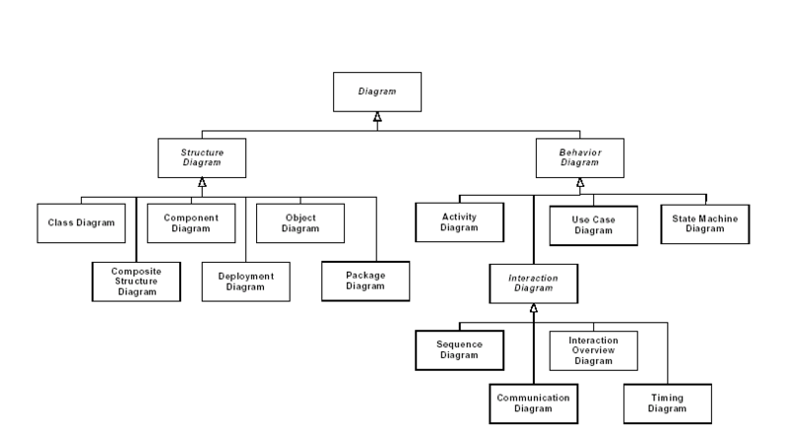
UML Diagram Hierarchy

Slide 4
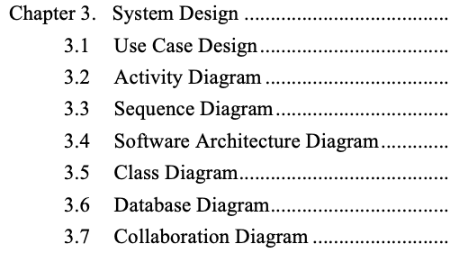
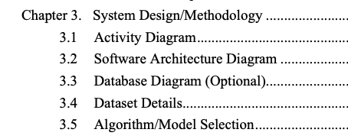
FYP Report
Development Project
R & D Project

Slide 5
Requirement Modelling
The intent of the requirement model is to provide a description of the required informational, functional, and behavioral domains for a computer-based system.
The model changes dynamically as you learn more about the system to build.
An approach that has a higher probability of uncovering omissions, inconsistencies, and ambiguity.

Slide 6
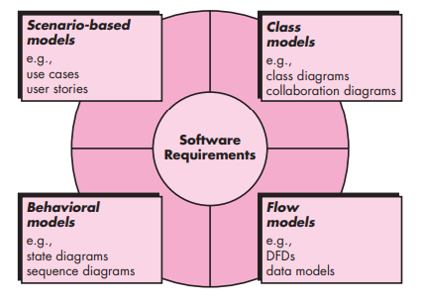
Requirement Modelling

Slide 7
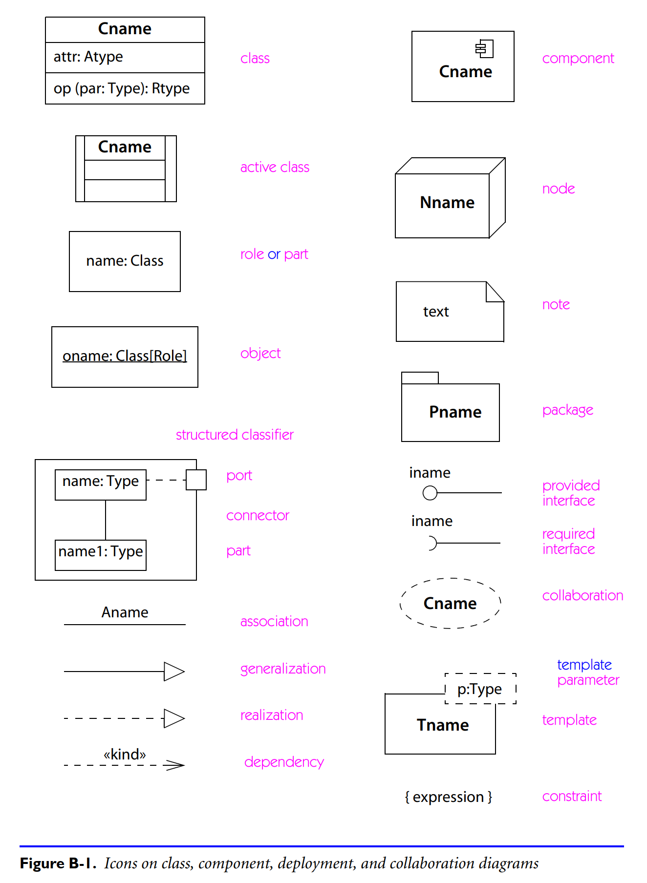

Slide 8
Use case diagram
Package
Use case
Watch
Actor
ReadTime
WatchUser
SetTime
WatchRepairPerson
ChangeBattery
Use case diagrams represent the functionality of the system from user’s point of view

Slide 9
Use case
system name
system boundary
ATM System
primary actor
1
Withdraw
Money
secondary actor
2
Deposit
Money
Bank Customer
Customer Accounts Database
3
Transfer
Money
role
association
4
Check
Balance
<<Customer
Accounts
Database>>
use case
alternative actor notation
stereotype

Slide 10
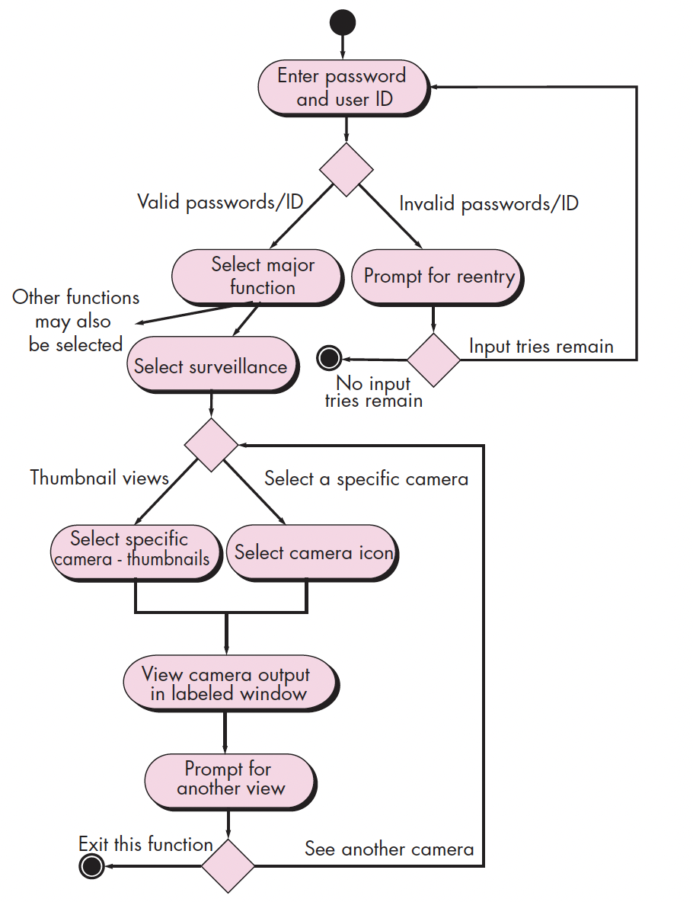
Activity diagram for Access camera surveillance

Slide 11
Class-based Modelling
It shows the classes of the system, their inter-relationships, and the operations and attributes of the classes
Explore domain concepts in the form of a domain model
Analyze requirements in the form of a conceptual/analysis model

Slide 12
Identifying Classes
  Classes are determined by underlining each noun or noun phrase and entering it into a simple table.
  If the class (noun) is required to implement a solution, then it is part of the solution space; otherwise, if a class is necessary only to describe a solution, it is part of the problem space.

Slide 13
Class diagram
Class diagrams represent the structure of the system
Association
Class
Multiplicity
Watch
1
1
1
1
2
1
2
1
PushButton
LCDDisplay
Battery
load
Time
now
state
blinkIdx
blinkSeconds()
blinkMinutes()
blinkHours()
stopBlinking()
referesh()
push()
release()
Attribute
Operations

Slide 14
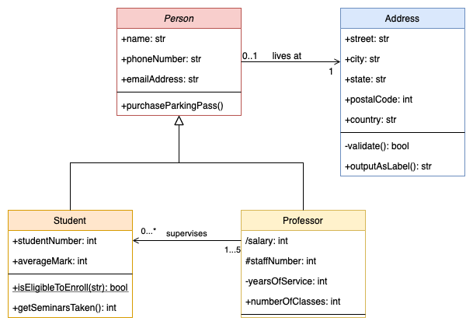
Class Diagram – Example 2

Slide 15
Sequence Diagrams
Describe the flow of messages, events, actions between objects
Show concurrent processes and activations
Show time sequences that are not easily depicted in other diagrams
Typically used during analysis and design to document and understand the logical flow of your system
Emphasis on time ordering!

Slide 16
Representing objects
Squares with object type, optionally preceded by object name and colon
  write object's name if it clarifies the diagram
  object's "life line" represented by dashed vert. line

Slide 17
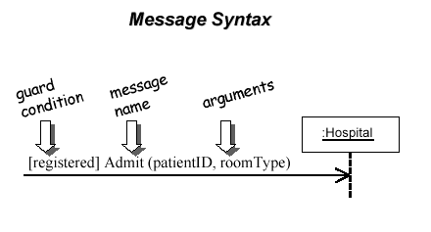
Messages between objects
message (method call) indicated by horizontal arrow to other object
  write message name and arguments above arrow

Slide 18
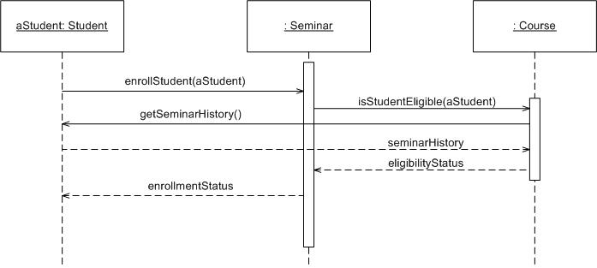
Sequence Diagram
Time Increasing -->
All lines should be horizontal to indicate instantaneous actions. Additionally if ActivityA happens before ActivityB, ActivityA must be above activity A
Lower = Later!

Slide 19
Components
execution
lifeline

Slide 20
Components
Method call
Return value

Slide 21
Summary - Sequence Diagram
Sequence diagrams model object interactions with an emphasis on time ordering
Method call lines
  Must be horizontal!
  Vertical height matters! “Lower equals Later”
  Label the lines
Lifeline – dotted vertical line
Execution bar – bar around lifeline when code is running
Arrows
  Synchronous call (you’re waiting for a return value) – triangle arrow-head
  Asynchronous call (not waiting for a return) – open arrow-head
  Return call – dashed line

Slide 22
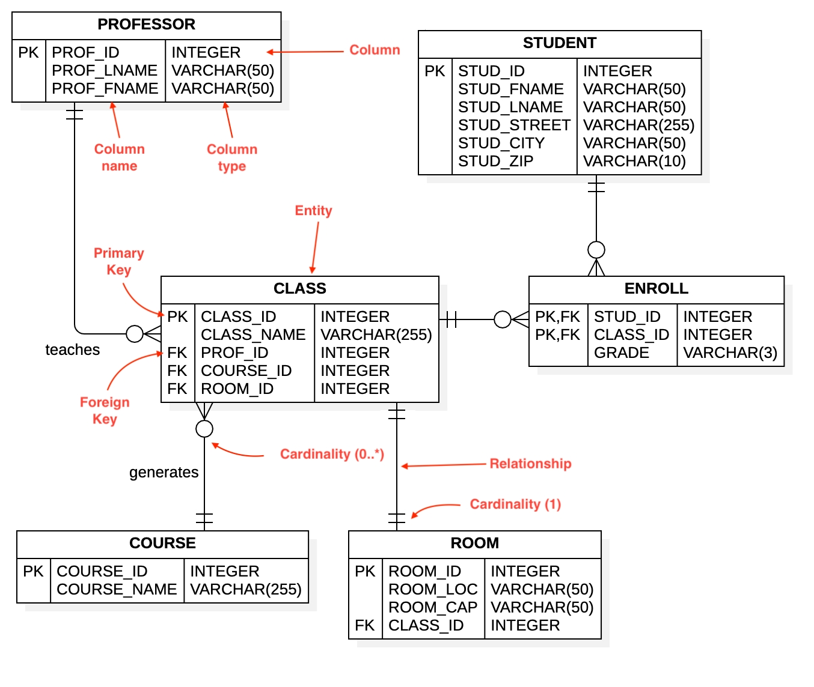
Entity
Relationship
Diagram..
Notes:
A dashed line means that the relationship is strong, whereas a solid line means that the relationship is weak.

Slide 23
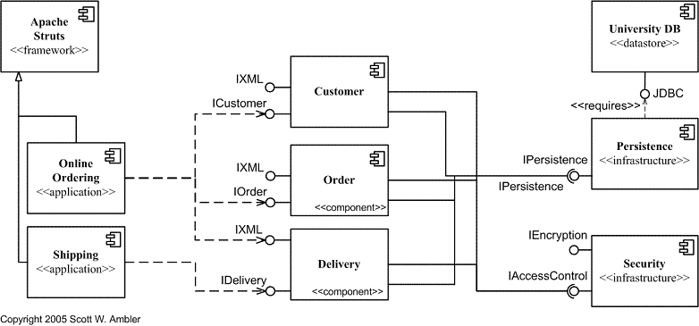
Component Diagram

Slide 24
Software Architecture Diagram
Software architectural diagramming is all about creating visual maps of your software system’s parts
Software architecture diagrams visually represent software components, relationships, and system interactions.
  Monilithic
  MicroServices
  MVC
  Master-Slave
  Eevent Driven
  Layered

Slide 25
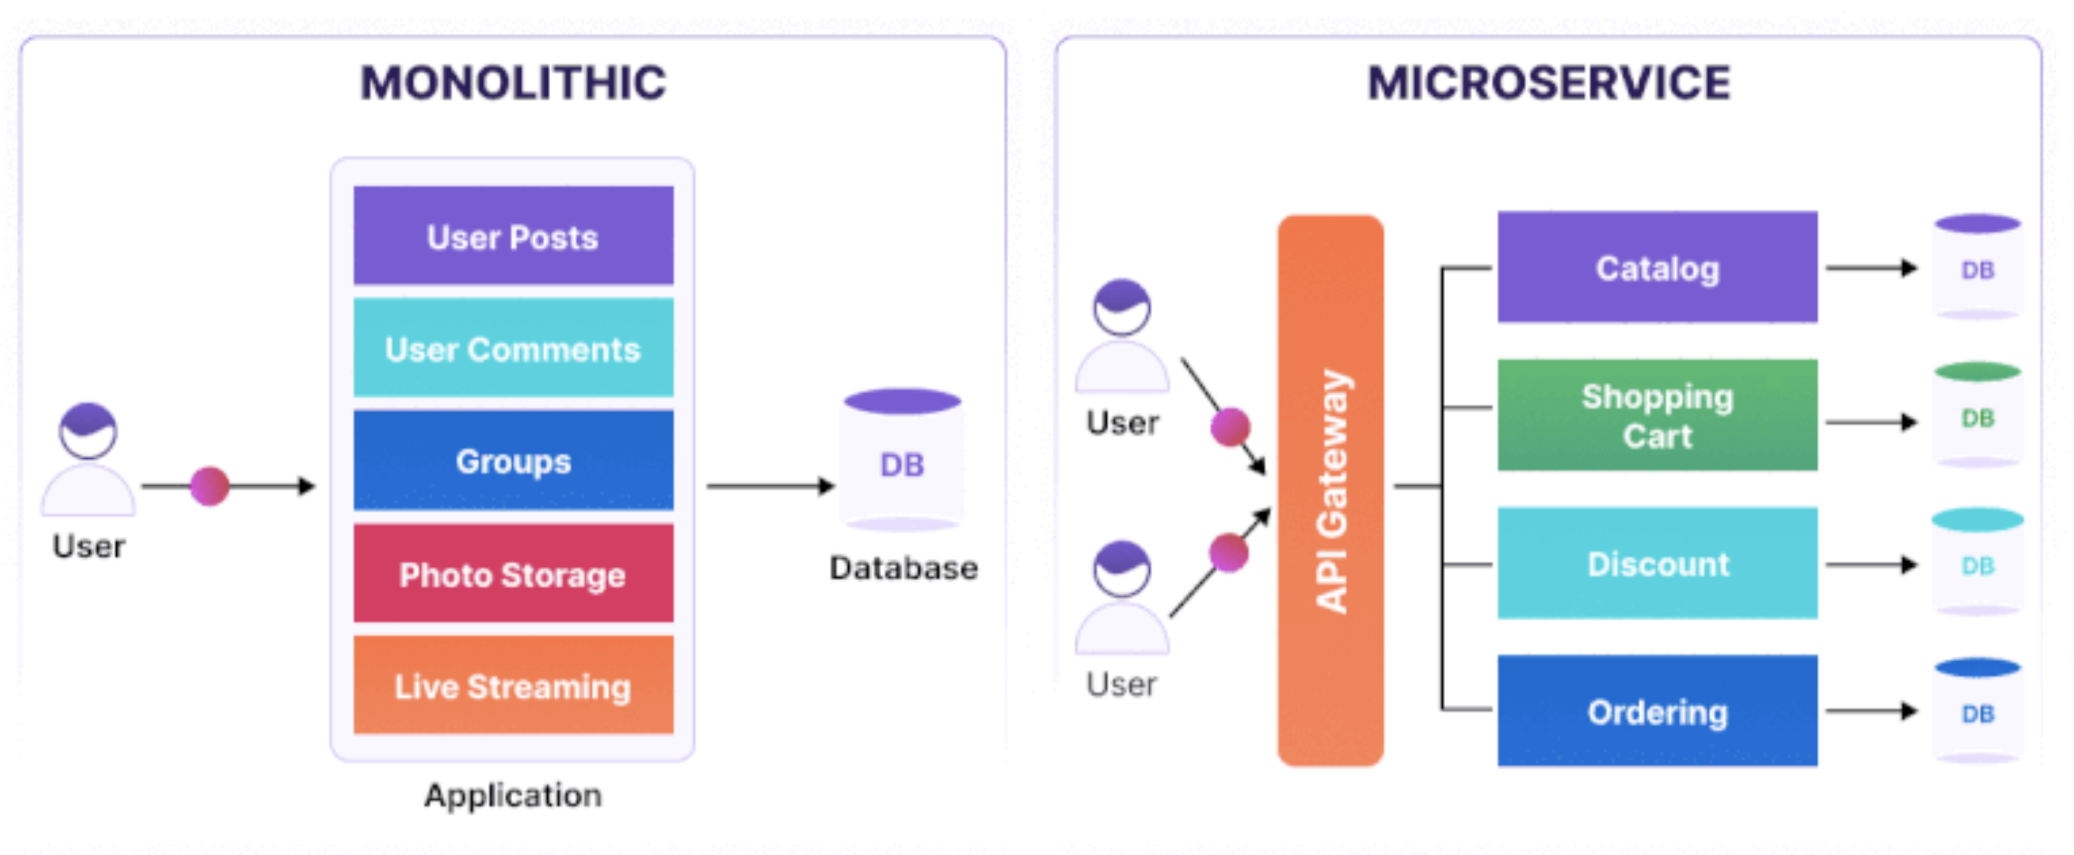
Monilithic Vs MicroServices

Slide 26
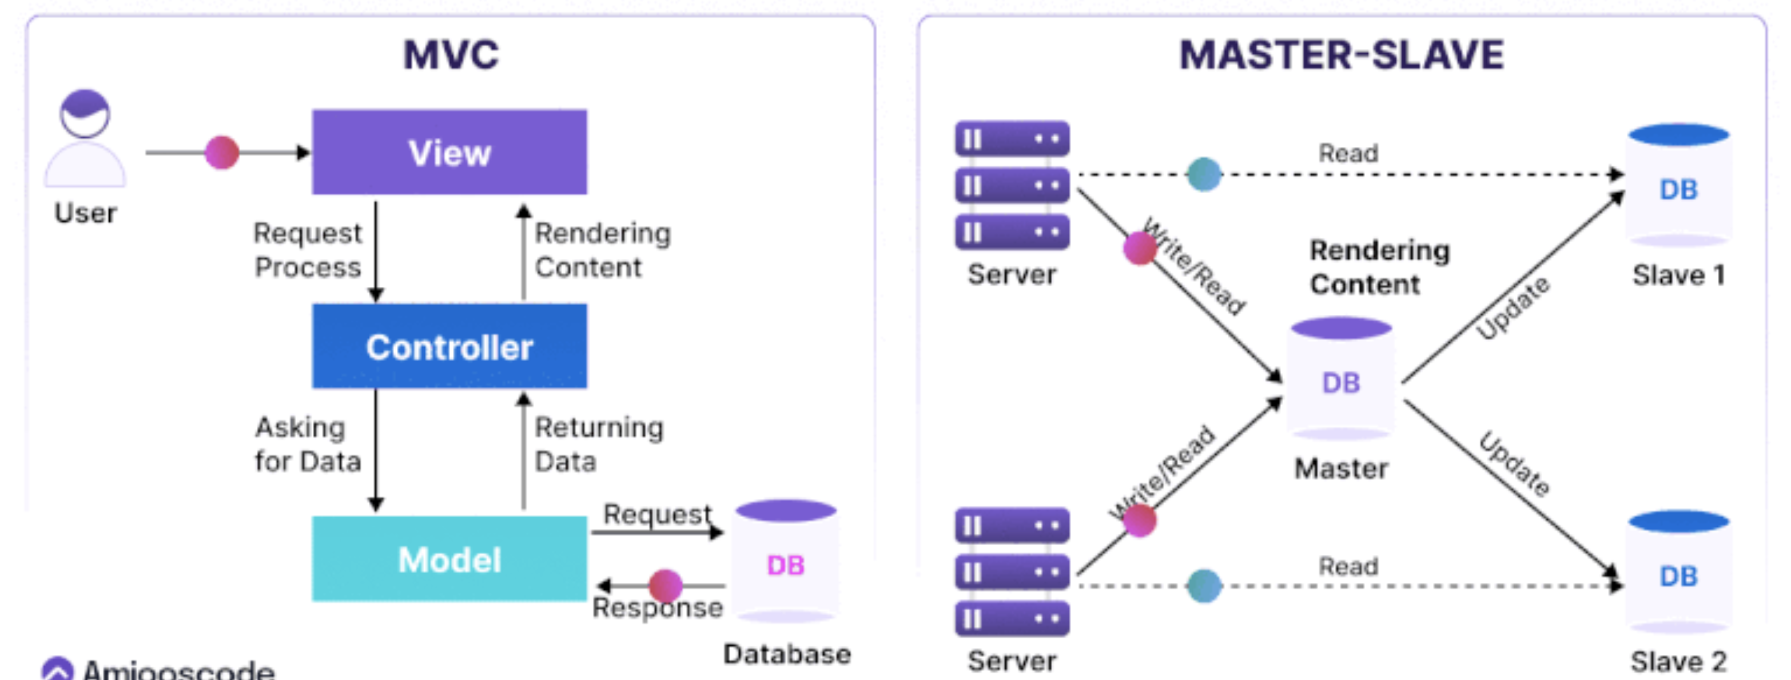
MVC Vs Master-Slave

Slide 27
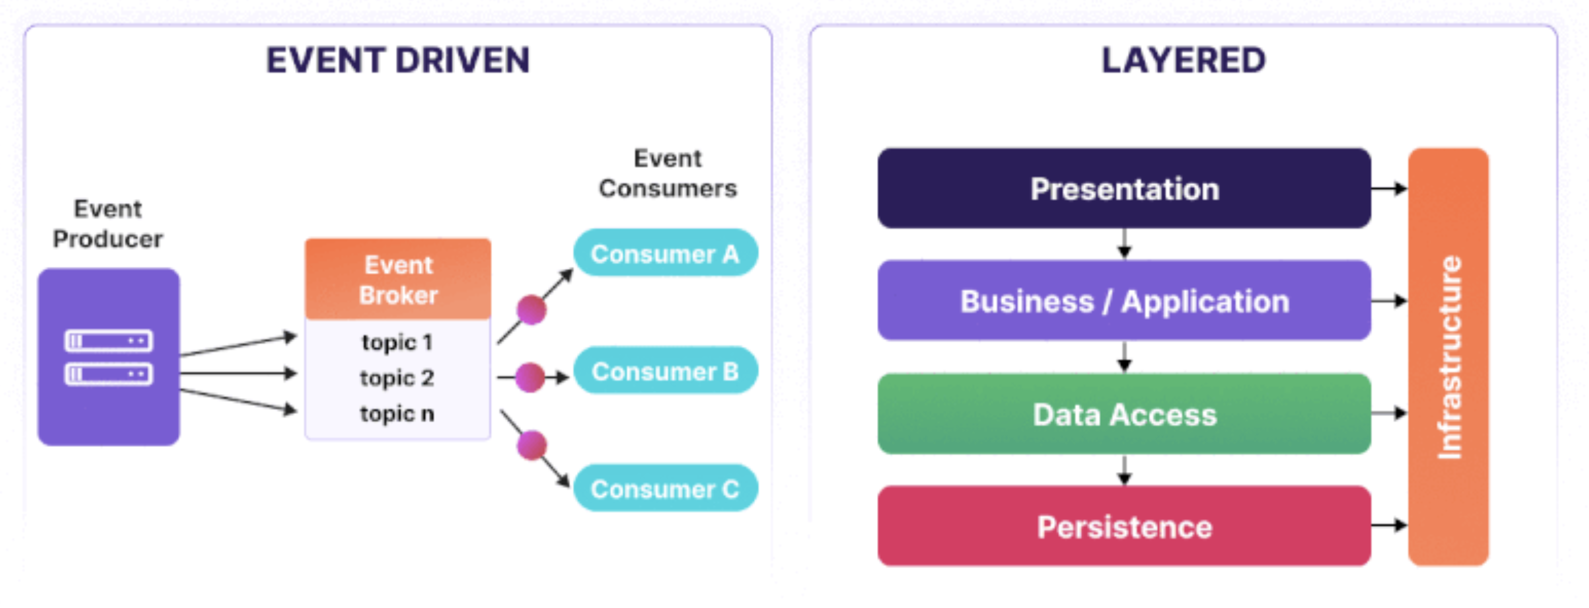
Eevent Driven Vs Layered

Slide 28
CASE
(Computer-Aided Software Engineering)
Tools

Slide 29
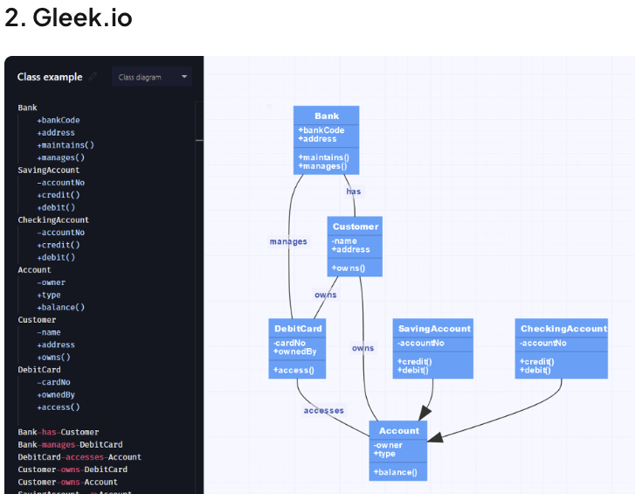

Slide 30
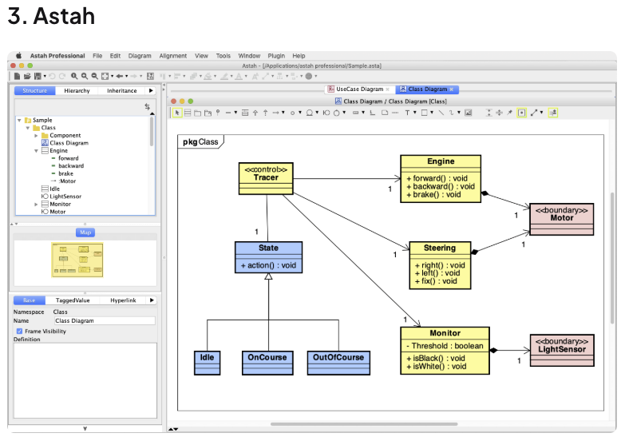

Slide 31
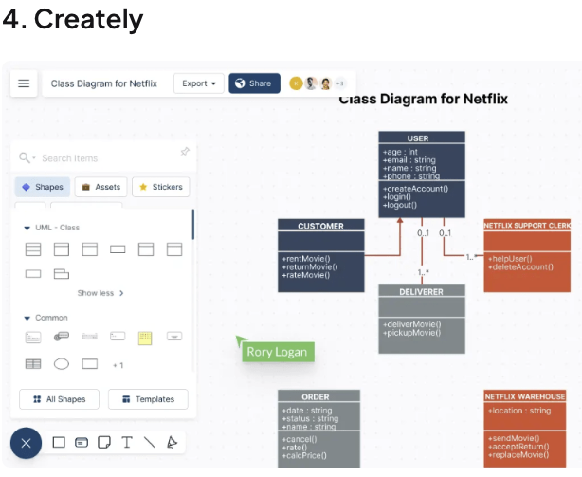

Slide 32
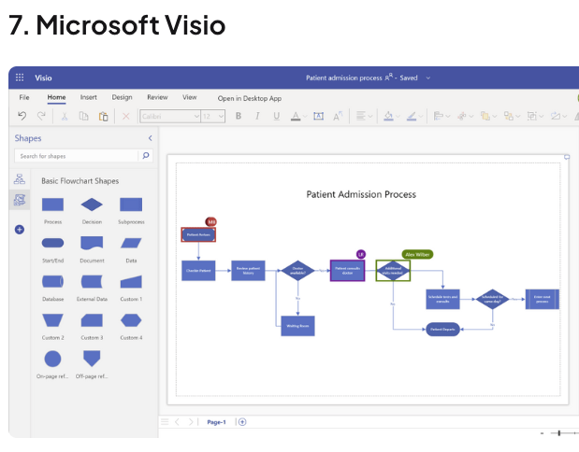

Slide 33
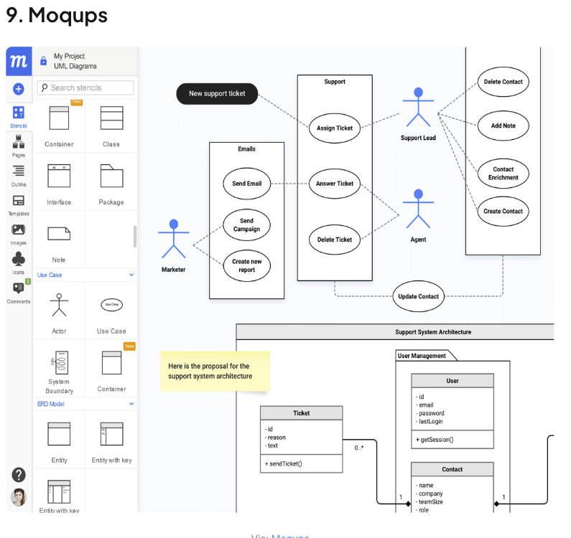

Slide 34
References
http://www.visual-paradigm.com/VPGallery/diagrams/index.html
http://en.wikipedia.org/wiki/Unified_Modeling_Language
http://pigseye.kennesaw.edu/~dbraun/csis4650/A&D/UML_tutorial/index.htm
http://www.agilemodeling.com/

