Slide 1
How to Clear Your First Coding Interview
Comsats University

Slide 2
My Introduction
I am Saad Ali
Software Engineer @Pakwheels
BS Computer Engineering from UET Lahore

Slide 3
Interview Process

Slide 4
Resume Shortlisting…
Hundreds of CVs

Slide 5
How to get a call for an Interview ?
Education
Projects
Certifications
CGPA greater than 3

Slide 6
What if i have shortlisted 10 candidates, all of them have above qualities ? and I only have 1 position available

Slide 7
How to ask someone to refer / recommend you ?
Find someone from your alumnus [recommend]
Approach someone on Linkedin [referral]
Be humble to ask for referral or recommendation even your resume is super cool

Slide 8
My story of being myself that results me failing an interview

Slide 9
Coding Interview Cycle
Phone Call Interview
With an HR
Technical Round 2
Project manager or Team Lead
Technical Round 1
2 years experience software engineer
Offer Letter
Salary Negotiation with an HR

Slide 10
1st Round
HR Call

Slide 11
HR’s Round
Tell me about yourself
What stack are currently working in.
Why do you want to switch (experienced fellows)
Expected Salary

Slide 12
Tell me about yourself ?
How to answer this question,
your point of view ?

Slide 13
Elevator Pitch
Intro
brief (think 30 seconds!) way of introducing yourself. Why it is called elevator pitch ?
Do’s
Name, current job, education, goals , relevant hobbies
Don'ts
Irrelevant hobbies, personal information

Slide 14
“Hey, I am Saad Ali. I am a Software Engineer with 1.5 years of experience with expertise in Python Django and Rails. I have graduated from UET Lahore in 2022 with the degree of Bsc Computer Engineering. In addition to my full-time role in software engineering, I've been passionately engaged in educating students worldwide for the past two years. As an online instructor, I've had the privilege of teaching core computer science principles and coding, imparting knowledge to a diverse and global audience.”
My Elevator pitch Anyone wants to share his/her pitch?

Slide 15
Technical Round (I)

Slide 16
Goal
To test your knowledge, covered over the span of 8 semesters.
Analytical reasoning
Communication Skills
Body language
Is he/she a best fit for a team.

Slide 17
Your Resume drives your Interview

Slide 18
Object Oriented Programming
Link
Theoretical Concepts

Slide 19
Why OOP is important
In real-world coding, we mostly use object-oriented programming.
So It is very important for a candidate to understand OOP concepts

Slide 20
Final Year Project

Slide 21
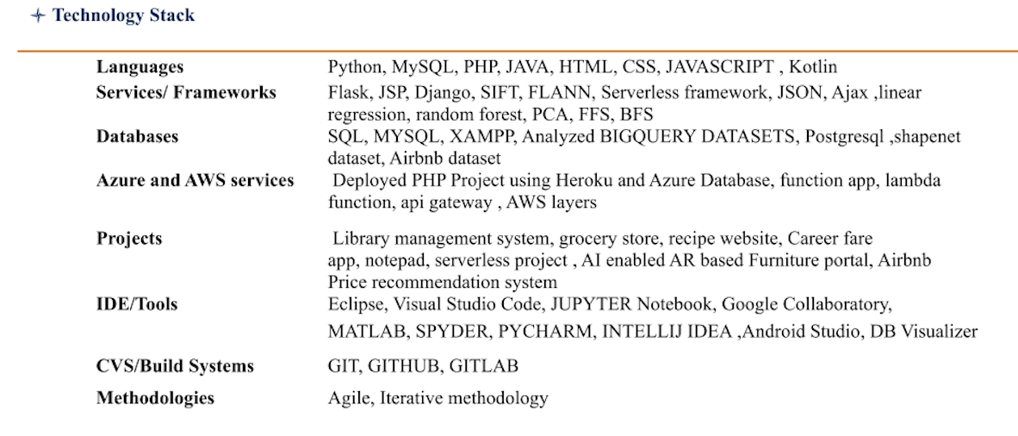
Key Points
Share your true contribution
Sharing extra will add more value, is a myth
Share Outcomes & your achievements
Only share stuff that you can justify

Slide 22
Story time - Atif

Slide 23
Market yourself is equally important to mastering a skill

Slide 24
Problem Solving

Slide 25
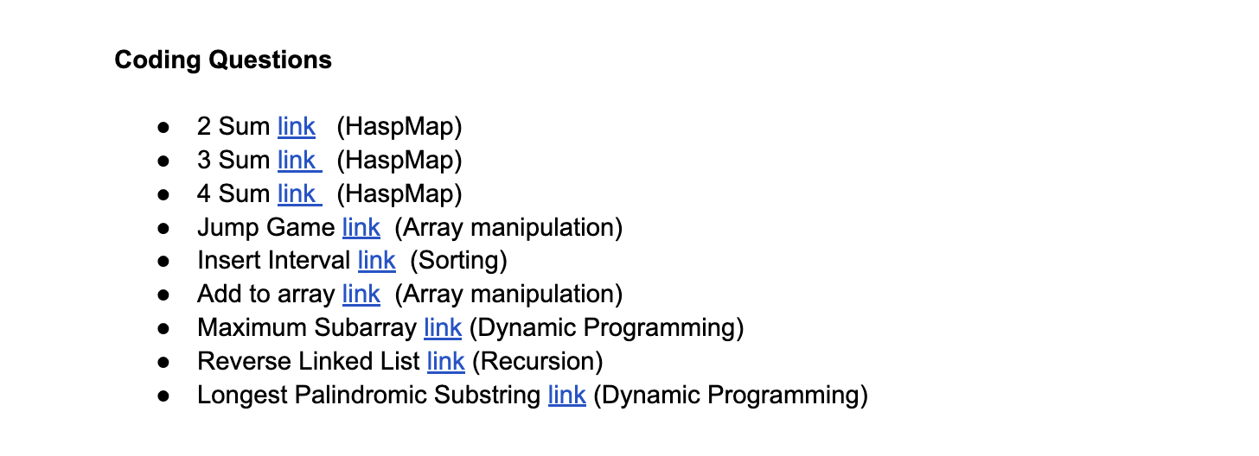
Problem Solving
Practice, practice and practice
It's not about how many problems you solve, it's about how many good problems you solve
It’s all about mapping a problem onto base method

Slide 26
Myths
Asking a lot of questions will put bad impression on interviewer
Not selecting a coding language according to companies stack

Slide 27
Databases

Slide 28
Database
Queries
System Design

Slide 29
Analytical Reasoning

Slide 30
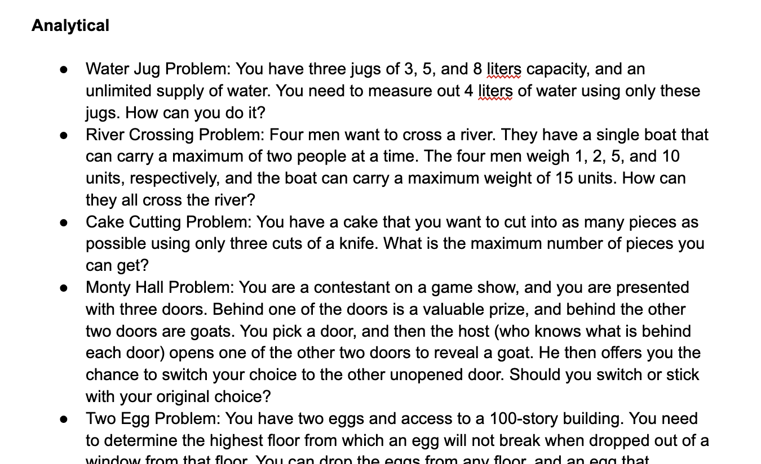
To the point
Practice
Problems

Slide 31
Things to consider before accepting offer

Slide 32
Points
No contracts
In demand technologies
Perks ( independent of base salary)
Notice period conditions

Slide 33
Good luck with your interviews

Slide 34
QnA

