Slide 1
Treatment of Operational Risk by IFIs
Mujtaba Khalid

Slide 2
Summary
Islamic Financial Institutions and Risk
Shariah Auditing
Shariah Risk Management for Common Islamic Financial Contracts

Slide 3
Islamic Financial Institutions and Risk

Slide 4
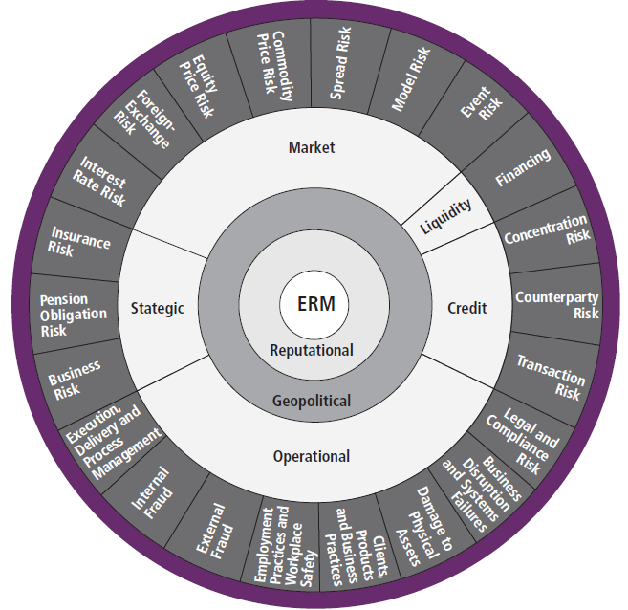
Types of Risks Faced by Financial Institutions
Rate of return
Shariah non-compliance
Displaced Commercial
Equity Investment
Unique
Islamic Banks
Generic
Credit
Market
Liquidity
Operational

Slide 5
Understanding Contractual Relationships in Islamic Banking
Terms | Conventional | Islamic
Deposits | Lender/Borrower | Custodian / Entrepreneur Financier / Capital Provider Safe Custody (Wadiah) Investment / Profit Sharing (Mudarabah)
 | Interest Based Deposits
Financing | Interest Based Loans | Debt Financing (Bai Bithaman Ajil, Murabahah) Equity Financing/ Profit Sharing (Musharakah /Mudarabah) Trading (Buy & Sell - Bai)
 | Lending/Borrowing

Slide 6
Understanding Islamic Financial Statements
One Stop
Shopping
Bank
ASSETS
Cash & cash equivalents
Sales receivables
Investment in securities
Investment in leased assets
Investment in real estate
Equity investment in joint ventures
Equity investment in capital ventures
Inventories
Other assets
Fixed assets
LIABILITIES
Current accounts
Other liabilities
Equity of Profit Sharing Investment Accounts (PSIA)
Profit Sharing Investment Accounts (PSIA)
Profit equalization reserve
Investment risk reserve
Owners’ Equity
Buying physical assets before selling
Direct equity investment
Leasing and trading in real estate
Fund management
Investment in Sukuk
Off-balance sheet assets

Slide 7
IFIs and Risk
The asset-based nature of financing products in IFIs such as Murabahah, Salam, Istisna and Ijarah may give rise to additional forms of operational risk in contract drafting and execution that are specific to such products. And also Investing modes Mudarabah and Musharakah.

Slide 8
Operational Risks – IFI Specific
Non-compliance with Shariah rules and principles in the
IFIS’ operations
Fund Provider’s Withdrawal
Loss of Income
Voiding of Contracts
Leading to diminished reputation, limited business opportunities, financial losses etc.
Shariah Non-Compliance Risk
IFI Specific Operational Risk
Fiduciary Risk
IFI’s fiduciary responsibilities as Mudarib
towards fund providers

Slide 9
Shariah Non-compliance in Financial Transactions
Financial Transaction
Contractual Form of the Transaction – Underlying Shariah contract
Legal Documentation

Slide 10
Shariah Non-Compliance with Respect to Credit Risk and Default - Example
Investment Dar Co KSSC v Blom Development Bank Sal [2009] - Sukuk Default
Kuwait's troubled shareholding company The Investment Dar (TID) refused to pay Lebanon's Blom Bank USD $10.7 million, saying that their original deal did not comply with Islamic law
According to a legal brief circulated, Blom sued the company in a British court, asking for the principal it invested plus a 5% return, as structured in a deal it conducted with Dar in 2007
Ironically, TID argued that the Wakalah agreement which was approved by its own Shariah board did not comply with the Shariah and was therefore void because it was against TID’s constitutional documents. The contract called for the company to return the principal investment plus a fixed profit — a deal Dar's attorneys said constituted interest, which is prohibited under Shariah law
The learned judge agreed that the issue of Shariah compliance needed to go to trial for proper deliberation, but considering the deposit, TID still had to pay the amount deposited of USD 10,733,292.55 to the BDB. Due to various reasons, the case was withdrawn.

Slide 11
Illustrative Example of Shariah Non-Compliance
Foreclosure case against the defaulting customer
If an Islamic bank files a lawsuit against a customer who has defaulted on Murabahah payments, the judgment may be turned in favor of the defendant (i.e., customer) such as the case of Arab Malaysian Finance Bhd v Taman Ihsan Jaya Sdn Bhd & Ors when the Judge ruled the contracted BBA (Murabahah) as a non bona fide sale because it constitutes a financing facility with a charge agreement.
As the contract is void, the customer was to only give back the principle amount advanced by the bank. This also means that the bank had to return any profit it had acquired from the customer, if total payments at default exceeded the original amount.

Slide 12
Explanation – Conventional Bank
Omar is keen to purchase a $ 200,000 apartment.
He meets the developer/vendor and signs a Sale and Purchase agreement (S&P) after placing a 10% down payment, $ 20,000.
Omar seek to borrow the remaining sum of $ 180,000 from a conventional bank.
On approval of the loan, $ 180,000 is paid to the developer.
Omar will pledge the property as collateral via the charge agreement on the $ 180,000 loan. Assuming the interest rate is at a flat 4% over 20 years, Omar will pay the bank $ 144,000 in interest.
Monthly instalment = (180,000 + 144,000) / 240 = $ 1,350.

Slide 13
Explanation – Islamic Bank
The transaction becomes complicated when an Islamic Bank is not involved in the sale and purchase agreement (S & P) with Omar
How can an Islamic bank observe the rules of Murabahah (to sell the property to Omar) when in the first place, it does not own the asset? The Holy Prophet (s.a.w.) says, “Do not sell what you do not own.”
How to overcame this Shariah stipulation?
To observe this Shariah rule, the Islamic bank purchases the property from Omar via the Property Purchase Agreement (PPA for $ 180,000). The bank makes the $ 180,000 disbursement to Omar, which it passes on to the developer.
Once the Islamic bank holds ownership via PPA, it then sells the property to Omar via the Property Sale Agreement (PSA).

Slide 14
Measuring the Cost of Shariah Non-Compliance
Building on from the previous example, we can deduce three cases:
CASE A
The paid amount is less than the original facility, e.g. 75 monthly payments before defaulting.
CASE B
The paid amount is equal to the original facility e.g. 134 monthly payments before defaulting.
CASE C
The paid amount is more than the original facility, e.g. 185 monthly payments before defaulting.

Slide 15
Case A
Omar seeks to borrow the remaining sum of $ 180,000 from an Islamic bank.
Assuming the Ijarah rate is at a flat 4% over 20 years, Omar will pay the bank $ 144,000 in interest.
Monthly instalment = (180,000 + 144,000) / 240 = $ 1,350
Omar has paid $101,250 (75 months monthly instalment) before defaulting. The outstanding balance is $ 222,750.
However, the court has ruled the nullification of Murabahah and the profit elements of the 75 instalments paid are to be clawed back and returned back to the customer.
Calculate – Principal and Profit portion of payment, Payment made to Bank, Loss to Bank

Slide 16
Calculations
Financing/Principal: $ 180,000 + Profit = $ 144,000 → Selling price = $ 324,000
Tenure = 20 years; Number of installment payments = 240
Monthly Payment = $ 1,350; Principal = $ 750, Profit = $ 600
Payment before default = $ 101,250 (75 monthly payments); Principal = $ 750 x 75 = $ 56,250; Profit = $600 x 75 = $ 45,000
Outstanding balance = $ 1,350 x 165 months = $ 222,750.
Remaining Balance for Omar to pay: $ 180,000 – $ 101,250 = $ 78,750
Loss to the bank: $ 45,000 to be clawed back from actualized earnings – to be paid to charity. S & P agreement: Title of the property still with the client.

Slide 17
Case B
Omar seeks to borrow the remaining sum of $ 180,000 from an Islamic bank.
Assuming the Ijarah rate is at a flat 4% over 20 years, Omar will pay the bank $ 144,000 in interest.
Monthly instalment = (180,000 + 144,000) / 240 = $ 1,350
Omar has paid $180,900 (134 months monthly instalment) before defaulting. The outstanding balance is $143,100.
However, the court has ruled the nullification of Murabahah and the profit elements of the 134 instalments paid are to be clawed back and returned back to the customer.
Calculate – Principal and Profit portion of payment, Payment made to Bank, Loss to Bank

Slide 18
Calculations
Financing/Principal: $ 180,000 + Profit = $ 144,000 → Selling price = $ 324,000
Tenure = 20 years; Number of installment payments = 240
Monthly Payment = $ 1,350; Principal = $ 750, Profit = $ 600
Payment before default = $ 180,900 (134 monthly payments); Principal = $ 750 x 134 = $ 100,500; Profit = $ 600 x 134 = $ 80,400
Outstanding balance = $ 1,350 x 106 months = $ 143,100.
Bank to pay Omar: $ 180,000 – $ 180,900 = $900
Loss to the bank: $80,400 to be clawed back from actualized earnings – to be paid to charity. S & P agreement: Title of the property still with the client.

Slide 19
Case C
Omar seeks to borrow the remaining sum of $ 180,000 from an Islamic bank.
Assuming the Ijarah rate is at a flat 4% over 20 years, Omar will pay the bank $ 144,000 in interest.
Monthly instalment = (180,000 + 144,000) / 240 = $ 1,350
Omar has paid $ 249,750 (185 months monthly instalment) before defaulting. The outstanding balance is $74,250.
However, the court has ruled the nullification of Murabahah and the profit elements of the 185 instalments paid are to be clawed back and returned back to the customer.
Calculate – Principal and Profit portion of payment, Payment made to Bank, Loss to Bank

Slide 20
Calculations
Financing/Principal: $ 180,000 + Profit = $ 144,000 → Selling price = $ 324,000
Tenure = 20 years; Number of installment payments = 240
Monthly Payment = $ 1,350; Principal = $ 750, Profit = $ 600
Payment before default = $ 249,750 (185 monthly payments); Principal = $ 750 x 185 = $ 138,750; Profit = $ 600 x 185 = $ 111,000
Outstanding balance = $ 1,350 x 55 months = $ 74,250.
Bank to payback Omar = $249,750 - $ 180,000 = $ 69,750
Loss to the bank: $111,000 to be clawed back from actualized earnings – to be paid to charity. S & P agreement: Title of the property still with the client.

Slide 21
Fiduciary Risk
A fiduciary duty is a legal duty to act in another party's interests. Parties owing this duty are called fiduciaries. The individuals to whom they owe a duty are called principals.
AAOIFI (1999) defines fiduciary risk as being legally liable for a breach of the investment contract either for noncompliance with Shariah rules or for mismanagement of investors’ funds.
Fiduciary risk also exposes equity holders and investment depositors to the risk of economic losses, as they would not receive their share of the profits.

Slide 22
Fiduciary Risk – Occurrence
Fiduciary Risk
Partnership based investments – In the case of Mudarabah and Musharakah investments on the asset side, the bank is expected to perform adequate screening and monitoring of projects. Any intentional negligence in evaluating or monitoring the project can lead to fiduciary risk
Mismanagement of funds– of current account holders having being accepted on a trust (Ammanah) can expose the bank to fiduciary risk. IBIs use funds of current account holders without being obliged to share profits.
Mismanagement – In governing the business by incurring unnecessary expenses or allocating excessive expenses to investment account holders is breach of implicit contract to act in a transparent fashion

Slide 23
Shariah Auditing

Slide 24
Shariah Auditing
According to GSIFI 2 of AAOIFI,
Shariah Review is an examination of the extent of an IFI’s compliance, in all its activities, with the Shariah. This examination includes contracts, agreements, policies, products, transactions, memorandum and articles of association, financial statements, reports (especially internal audit and central bank inspection), circulars, etc. The objective of a Shariah review is to ensure that the activities carried out by an IFI do not contravene the Shariah.
While the SSB is responsible for forming and expressing an opinion on the extent of an IFI’s compliance with the Shariah, the responsibility for compliance therewith rests with the management of an IFI

Slide 25
Zakat Calculation & Payment
Human Resource Management
Contracts and Agreements
Scope of Shariah Audit
Business Policies
Environmental Impact
Marketing and Advertisement

Slide 26
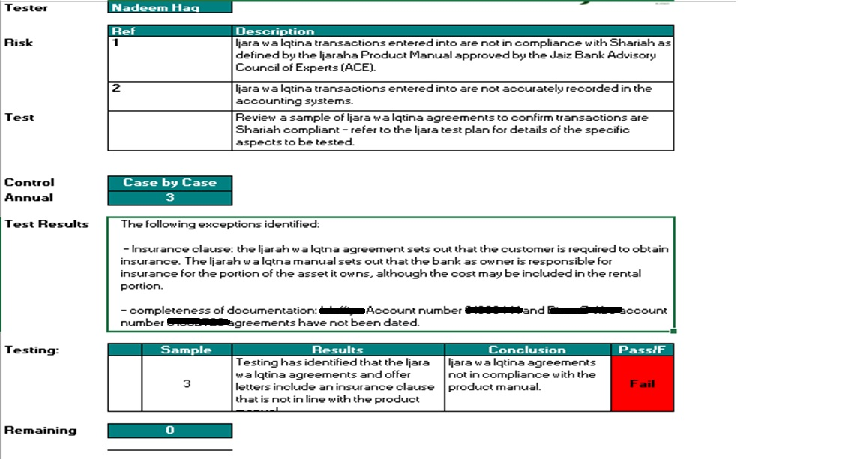
Example Shariah Audit Test Plan for Ijarah

Slide 27
The Risk Management Process

Slide 28

The Risk Management Process
Identification
Assessment
Management
Review
Involve all relevant parties
Continuous cycle
Revisit regularly
Impact
Likelihood
Develop strategies
Channel resources

Slide 29
Managing Operational Risk
Employee training
Close management oversight
Segregation of duties
Employee background checks
Implementing proper procedures and processes
Purchase of insurance
Exiting certain businesses

Slide 30
Shariah Non-Compliance Risk Management
Do the terms of the transaction comply with Shariah Law?
Is this the best investment option for the client?
Does the investment produce value for the client and for the community in which the client is active?
As an asset manager, is this a transaction in which the banker as an individual is also willing to invest?
If the answer to any of the above is no, the proposed transaction should be rejected

Slide 31
Shariah Risk Management for Common Islamic Contracts

Slide 32
Mudarabah Deposits
Stage | Shariah Non-Compliance Risk
Contract | The bank cannot contract to provide a fixed return on deposits
 | Reserve maintenance risk – The bank should ensure an adequate return to protect deposit holders and bank’s shareholders. Both the Profit Equalization and Investment Risk Reserves should be managed diligently
Profit Attribution | The bank must insure that the rate of return paid back to deposit holders takes into account the added equity risk taken by deposit holders and is attractive compared to other options in the market
Presentation | AAOIFI standards require Islamic banks to present the depositor’s fund as a form of equity, therefore may banks face complex issues in application of prudential reserve requirements. Restricted investment account holders have to be shown in an off balance sheet statement

Slide 33
Ijarah Shariah Risk Management
Stage | Shariah Non-Compliance Risk
Agreement to Lease Promise (Binding) | Lease of consumables – The Islamic Bank should not enter into a lease of consumables or edible commodities
Order/Receipt of Asset | No rental should be applicable before delivery of asset to the customer
Contract | Ownership Transfer – Ownership to be transferred at end of the lease period. If ownership has been transferred, rentals on such assets would be equivalent to charging interest on financing
 | Non-Existent Asset – Entering into a lease of non-existent asset may lead to disputes
 | Late Payment – A lessee may undertake to donate to charity a certain percentage of the rental incase of late payment, however, no late payment penalty may be charged to the bank
Rejected/ Defective Asset | Mutual Dissolution – additional cost of providing an alternate asset maybe borne by the Islamic bank, if the leased asset is destroyed without negligence.
Default | The Islamic bank may not charge any penal interest in case of default in payment.

Slide 34
Steps Post Shariah Non-Compliance Identification
Where an institution becomes aware that it is carrying on any of its business in a manner which is not in compliance with Shariah the institution shall –
(a) Notify the bank’s Shariah committee of the fact;
(b) Immediately cease from carrying on such business, affair or activity and from taking on any other similar business, affair or activity; and
(c) Submit a plan on the immediate rectification of the non-compliance.
The bank should carry out an future assessments as it thinks necessary to determine whether the non-compliance has been rectified

Slide 35
جزاك اللهُ خيرًا
Thank you

