Slide 1



Operational Risk Management for Islamic Banks
Syed Ali Asad

Slide 2



Risk Management and Islam
And he said, “O my sons, do not enter (the city) all of you from the same gate, rather, enter from different gates. And I cannot help you in any way against (the will of) Allah. Sovereignty belongs to none but Allah. In Him I place my trust, and all those who trust should trust in Him alone.” (Yusuf: 67)

Slide 3
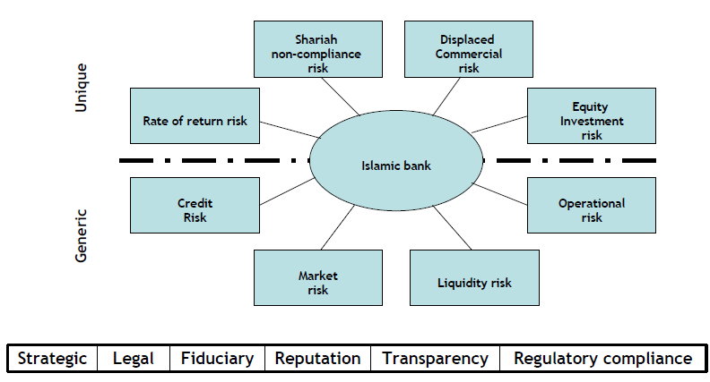
Risk Profile of Islamic Banks

Slide 4

Defining & Understanding
Operational Risk
“Operational risk is the risk of loss resulting from inadequate or failed internal processes, people, and systems or from external events.”
-Basel Committee on Banking Supervision
Islamic Banks (IBs) are also exposed to risk related to Shariah non-compliance, reputation, and fiduciary responsibilities.

Slide 5
Defining & Understanding
Operational Risk
Process Risk: Risks related to the execution and maintenance of transactions, and the various aspects of running a business, including products and services.
People Risk: The risk of a loss intentionally or unintentionally caused by an employee i.e. employee error, employee misdeeds—or involving employees, such as in the area of employment disputes. This risk class covers internal organizational problems and losses.
System Risk: The risk of loss caused by a piracy, theft, failure, break down or other disruption in technology, data or information; also includes technology that fails to meet business needs.
External Risk: The risk of loss arises due to damage of physical property/ assets from the natural or non–natural causes. This category also includes the risk presented by actions of external parties, such as the perpetration of fraud, or in the case of regulators, the execution of change that would alter the firm’s ability to continue operating in certain markets

Slide 6
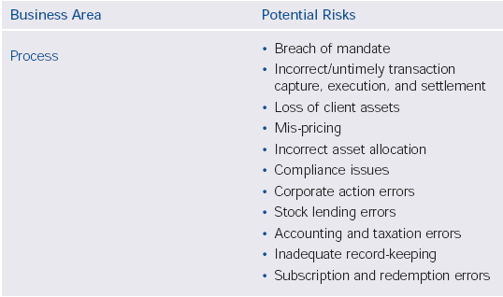
Defining & Understanding
Operational Risk

Slide 7
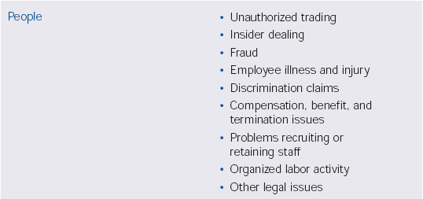
Defining & Understanding
Operational Risk

Slide 8
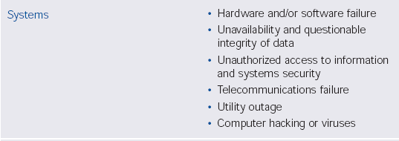

Defining & Understanding
Operational Risk

Slide 9
Defining & Understanding
Operational Risk

Slide 10
Defining & Understanding
Operational Risk
What risks are we talking about??
  A loan goes bad!
  Bank suffers losses due to adverse interest rate movement.
  A customer withdraws money incorrectly transferred to his/her account

Slide 11
Defining & Understanding
Operational Risk
“More than 80% of our Credit risk is really just Operational risk.”
Senior Risk Officer,
Large German Bank

Slide 12
Defining & Understanding
Operational Risk
  Causes of Op Risk
    Internal fraud
    External fraud
    Employment practices and workplace safety
    Clients, products and business practices.
    Damage to physical assets.
    Business disruption and system failures
    Execution, delivery and process management

Slide 13
Basel II – Evolution of Ops Risk
1988 Capital Accord
  Too simplistic
  Subject to manipulations
  Encouraged more risk taking
  Leading banks, using sophisticated models realized that they were ‘over capitalized’ and lobbied for a more risk sensitive capital framework.

Slide 14
Basel II – Evolution of Ops Risk
The Basel II Accord
  Basel II is based on the fundamental principal that risk capital should be based on level of risk (i.e., risk sensitive).
    Incentive: Requiring banks to hold capital based on their actual level of risk would give banks an incentive to reduce their level of risk
    Lessons from past experience (in market risk): risk measurement improves risk management.

Slide 15
Basel II – Evolution of Ops Risk
Basel II
Three Pillars
Minimum Capital Requirements
Supervisory Review
Market Discipline
Providing a flexible, risk-sensitive capital management framework

Slide 16
Basel II – Evolution of Ops Risk
Minimum Capital Requirement
Risk-weighted Exposures
Market Risk
Credit Risk
Operational Risk
Risk of losses in on and off balance sheet positions arising from movements in market prices
Potential that a bank borrower or counterparty will fail to meet its obligations in accordance with agreed terms
Risk of direct or indirect loss resulting from inadequate or failed internal processes, people and systems or external events
No Change
Major Changes
New element added

Slide 17
Basel II – Evolution of Ops Risk
PILLAR 2
Supervisory
Review
PILLAR 1
Minimum Capital
Requirements
Balance the flexibility and freedom given to banks
PILLAR 3
Market
Discipline
Risk Weights
Definition of
Capital
Credit Risk
Operational
Risk
Market Risk
Standardized
Approach
Internal Ratings
Based Approach
Asset
Securitization
Basic Indicator
Approach
Standardized
Approach
Advanced
Measurement
Approach
Foundation
Approach
Advanced
Approach
Standardized
Approach
Internal Ratings
Based Approach
Alternate Standardized Approach

Slide 18
Basel II – Evolution of Ops Risk
Minimum for all banks
Minimum for large banks
Target for leadings banks
Basic Indicator
Standardized
Advanced
Based upon an
institutional
Gross Income
Alpha
Based upon
Business Line
Gross Income Beta
Based upon Loss
Distribution
Approach. Scenarios or
Risk Drivers &
Controls
But also requires adherence to a set of “Sound Practices”

Slide 19
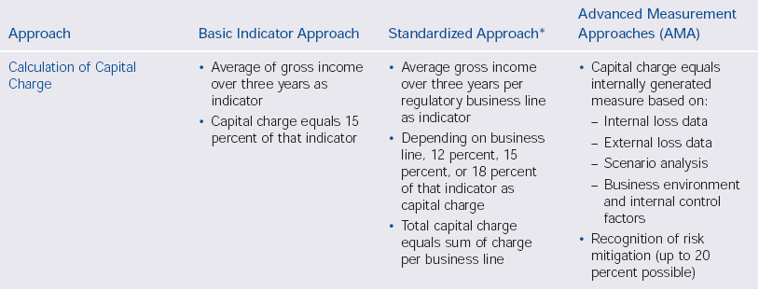
Basel II – Evolution of Ops Risk

Slide 20
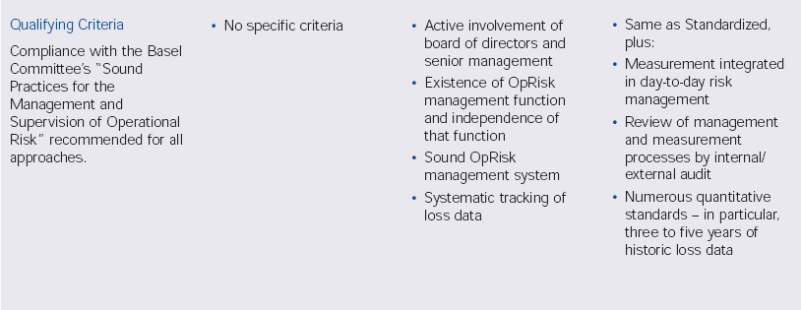
Basel II – Evolution of Ops Risk

Slide 21
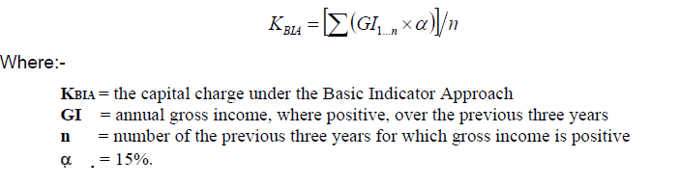
Basel II – SBP Guidelines
Basic Indicator Approach
  Under BIA the capital charge for operational risk is a fixed percentage of average positive annual gross income of the bank over the past three years.
  Negative or zero income to be excluded from the calculations
  The charge may be expressed as under

Slide 22
Basel II – SBP Guidelines
Basic Indicator Approach
  Gross income is defined as the sum of net interest income and net non-interest income and shall be arrived at before accounting for:
    (i) Provisions, including those for credit impairment;
    (ii) operating expenses
    (iii) realized profits/ losses from the sale of securities
    (iv) extraordinary items,
    (v) income derived from insurance.
  No qualifying criteria but banks are expected to follow SBP guidelines on risk management.

Slide 23
Basel II – SBP Guidelines
The Standardized Approach
  banks divided into eight business lines: corporate finance, trading & sales, retail banking, commercial banking, payment &settlement, agency services, asset management, and retail brokerage
  Within each business line, gross income to serve as a proxy for the scale of business operations and thus the operational risk exposure
  The capital charge for each business line is calculated by multiplying gross income by a factor (denoted beta) assigned to that business line.
  The total capital charge is calculated as the three-year average of the simple summation of the regulatory capital charges across each of the business lines in each year.

Slide 24
Basel II – SBP Guidelines
The Standardized Approach
  The total capital charge is calculated as the three-year average of the simple summation of the regulatory capital charges across each of the business lines in each year.
  In any given year, capital charges (resulting from negative gross income) in any business line may offset positive capital charges in other business lines without limit. However, where the aggregate capital charge across all business lines within a given year is negative, then the input to the numerator for that year will be zero. The total capital charge may be expressed as:
    K ^{TSA} = {Σ ^{years 1-n} max[Σ (GI¹⁻⁸ x β¹⁻⁸),0]}/n
    Where:
    K^{TSA} = the capital charge under the Standardized Approach
    GI¹⁻⁸ = annual gross income in a given year, as defined above in the Basic Indicator Approach, for each of the eight business lines
    β¹⁻⁸ = a fixed percentage, as given in table on next slide

Slide 25
Basel II – SBP Guidelines
The Standardized Approach
Business Lines | Beta Factors
Corporate finance | 18%
Trading and sales | 18%
Retail banking | 12%
Commercial banking | 15%
Payment and settlement | 18%
Agency services | 15%
Asset management | 12%
Retail brokerage | 12%

Slide 26
Basel II – SBP Guidelines
The Alternative Standardized Approach
  Under the ASA, the operational risk capital charge /methodology is the same as for the Standardized Approach except for two business lines – retail banking and commercial banking. For these business lines, loans and advances – multiplied by a fixed factor ‘m’ replaces gross income as the exposure indicator.
  KRB = bRB x m x LARB
  Where
  KRB is the capital charge for the retail banking business line
  bRB is the beta for the retail banking business line
  LARB is total outstanding retail loans and advances (non-risk weighted and gross of provisions), averaged over the past three years and
  m is constant the value of which is 0.035

Slide 27
Basel II – SBP Guidelines
The Alternative Standardized Approach
  Under the ASA, banks may aggregate retail and commercial banking (if they wish to) using a beta of 15%. Similarly, those banks that are unable to disaggregate their gross income into the other six business lines can aggregate the total gross income for these six business lines using a beta of 18%, with negative gross income treated as described above

Slide 28
Basel II – SBP Guidelines
TSA – Qualifying Criteria
  BoD oversight.
  Separate Operational Risk management function.
  Tracking ops loss data
  System of reporting ops risk exposure
  Well documented ORM, with policies and procedures.
  Periodic review to validate the ORM
  Regular review by external auditors.

Slide 29
ORM Principles for Islamic Banks
Shariah Compliance - SBP , Bank’s Own Shariah Advisor
Reputation & Perception Risk – Fund Providers , Customers
Fully Compliant at all times in all activities
Shariah Compliant Contract Documentation
Shariah Compliance Reviews
Assess actual as well as probable loss of income due to Shariah non-compliance
Risk Management Guidelines for Islamic Banking Institutions
Islamic Banking Department, State Bank of Pakistan

Slide 30
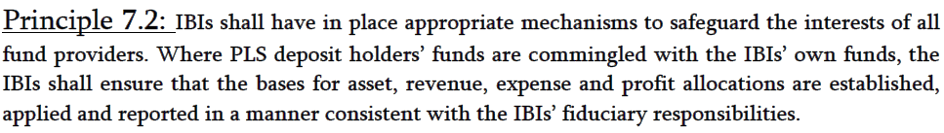
ORM Principles for Islamic Banks
Fiduciary Risk
Conflicting Roles
Policy to Manage different and potentially conflicting roles
Adequate and Timely disclosure
Risk Management Guidelines for Islamic Banking Institutions
Islamic Banking Department, State Bank of Pakistan

Slide 31
ORM Principles for Islamic Banks
Shariah compliance risk
- The risk that arises form Islamic banks’ failure to comply with the Shariah rules & principles determined by the Shariah Advisor or the relevant body in the jurisdiction in which Islamic banks operate
Fiduciary risks
- The risk that arises from the Islamic banks’ failure to perform in accordance with explicit and implicit standards applicable to their fiduciary responsibilities

Slide 32
Assessing Operational Risk Exposure
Required Process of Continuous Risk Assessment, Monitoring and Reporting
Risk
Identification
Control
Assessment
Likelihood and
Severity
Measuring/
Monitoring
Mitigation Planning
& Execution
Reporting

Slide 33
The Process
Risk Identification
Assessment of Control Framework
Risk Likelihood/Severity Assessment
Measurement & Monitoring
Reporting
Mitigation

Slide 34
The Tools
Control and Risk Self Assessment
Key Risk Drivers and Indicators
Loss Data
Issue and Event Data
Audit and Compliance Reports
Scenario Analysis

Slide 35
Categorizing Operational Losses
‘Event’ based categorization
  BIS framework is designed to be event based approach.
  While the risk universe consists of three independent dimensions; causes, events, consequences.
  It’s more logical to look at ops losses in a cause/effect matrix framework.
  Such an approach helps evolve better, valid and consistent controls

Slide 36
Categorizing Operational Losses
CAUSES
EVENTS
CONSEQUENCES
Inadequate
segregation of duties
Legal Liability
Internal
Fraud
Regulatory, Compliance & Taxation Practices
Insufficient training
External
Fraud
Less of Damage
to Assets
EFFECTS
Monetary
Losses
Lack of management
supervision
Employment Practices
& Workplace Safety
Restitution
Inadequate
auditing procedures
Clients, Products & Business Practices
Loss of Resources
Damage to
Physical Assets
Write-down
Inadequate security
measures
Business Disruption & System Failures
Execution, Delivery & Process Management
OTHER
IMPACTS
Forgone
Income
Reputation
Poor systems
design
Business Interruption
Poor HR
policies

Slide 37
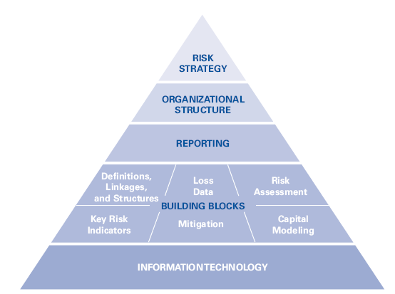
Managing Ops Risk
An operational risk framework

Slide 38
Managing Ops Risk
An operational risk framework
operational risk strategy comprises both
  the “top-down” process of capital allocation and
  clear guidance for the “bottom-up” processes of risk identification, assessment, management, reporting and supervision, and governance arrangements that constitute the management framework.
Setting the risk tolerance/risk appetite
  Bottom up and top down approaches.

Slide 39
Managing Ops Risk
Organizational Structure
Two key goals need to be reflected in an organizational structure for operational risk:
  The agreement that operational risk cannot be confined to specific organizational units (unlike market risk) but remains largely the responsibility of line managers and some defined special or support functions (such as IT, HR, legal, internal audit, or compliance)
  The division of duties among management, an (often to be established) independent risk management function, and internal audit.

Slide 40
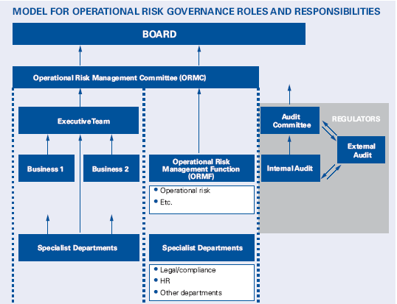
Managing Ops Risk

Slide 41
Basel II - Challenges & pitfalls
Challenges
  Organizational Sponsorship
  Business Line Buy-in and Resources
  Coordination with Existing Control Initiatives
  Development of Loss Databases
  Well-Designed Methodologies and Models
  Access to Appropriate Information and Reporting
Mistaking Operational Risk for Market or Credit Risk

Slide 42
Basel II - Challenges & pitfalls
Pitfalls
  Waiting for the regulators to provide detailed guidance and lay out an implementation road map
  Failing to make the link between information, technology, risk management and the business
  Attempting to build a Basel II infrastructure without data and technical architecture road maps
  Underestimating the magnitude of cultural change that Basel II requires

Slide 43
Operational Risk Management
Conclusions
  Management not Measurement
  Imprecise science
  Integrate measurement into Operational Risk Management framework
  Use data to make informed decisions
    Control framework
    Evaluate mitigation
    Prioritise corrective action
  Low frequency/High impact events drive operational risk capital!

Slide 44
THANKS!

