Slide 1
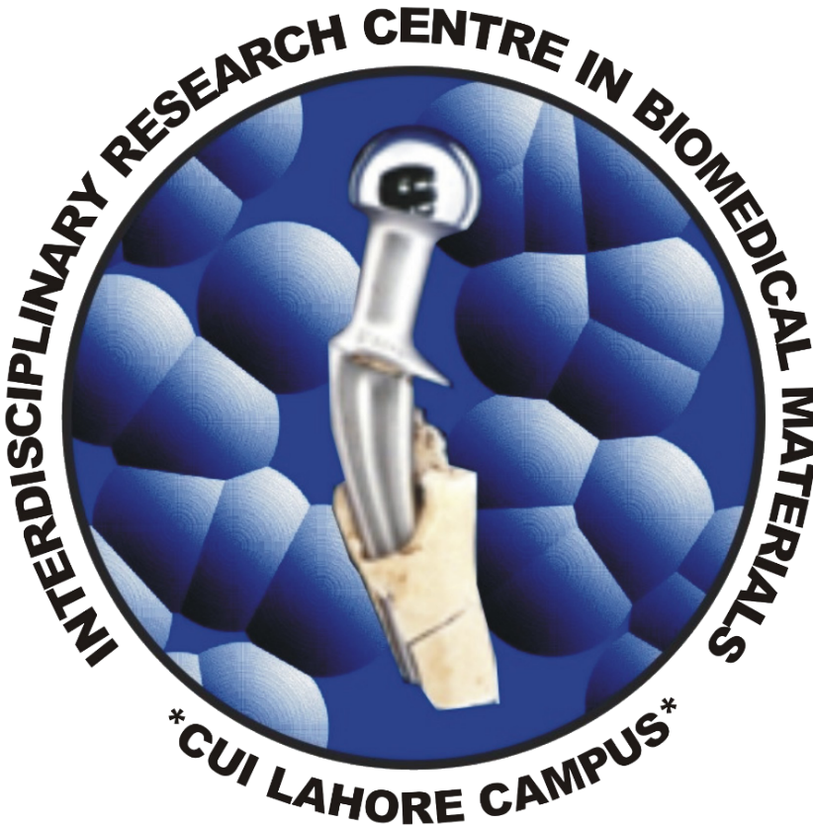
Synthesis of Carbonated Hydroxyapatite for Biomedical Applications
Usaid Azhar, Faisal Manzoor , Fakhera Ikram, Aqif Anwar Chaudhry, Saadat Anwar Siddiqi
Interdisciplinary Research Centre in Biomedical Materials (IRCBM), COMSATS University Islamabad, Lahore Campus, Defence Road, Off Raiwind Road, Lahore, Pakistan.
Electrospinning is an effective technology for producing poly(hydroxybutyrate-co- hydroxyvalerate)
(PHBV) nanometer-scale ﬁbrous scaffolds for tissue regeneration, electrospinning of PHBV ﬁbrous
scaffolds composed of surface-porous ﬁbres or nanocomposite ﬁbres is rarely explored. PHBV fibers
containing ion substituted hydroxyapatite (i-e CHA, Si-HA, Sr-HA, Mg-HA, Zn-HA and Sr-HA)
nanoparticles were electrospun with the help of ultrasonic power for distribution of the nanoparticles.
Scanning electron microscopy showed that the distribution of ceramic within the nanocomposite fibers
was homogeneous. The diameter of the electerspun nano-composite was in the range of 200 to 1000
nm. Fourier transform infrared spectroscopic analysis further confirmed the presence of HA in PHBV
nanofibers. Ions substitution HA shown the good viability with PHBV but the incorporation of the ZnHA
nanoparticles dramatically enhanced its viability. In vitro studies revealed that the ectrospun fibrous
membranes supported the proliferation of mice osteoblastic cells (MC3T3). The alamar blue assay
MC3T3 ells seeded on the ZnHA/PHBV fibrous membranes was higher than that of the cells seeded on
the other nano ions substituted HA/PHBV fibrous membranes after 14 days of cell culture. The
electrospun CHA/PHBV nanocomposite fibrous membranes show promises for bone tissue engineering
applications.
ACKNOWLEDGEMENTS
CONTACT US
Bone Repair and Regeneration Group @ IRCBM
Contact Person – Dr. Saadat A. Siddiqi (saadatanwar@cuilahore.edu.pk)
Group Contact – borrn@cuilahore.edu.pk
REGISTER NOW
&
CALL FOR POSTERS

